Slide 1


4 Days Training Program on
“Databricks Data Engineer Associate”
with Microsoft Azure
By : Sandeep Kumar Sharma

Slide 2

What is Cloud Computing ?

Slide 3


What is Cloud Computing?
Cloud computing refers to the delivery of computing services—including servers, storage, databases, networking, software, and more—over the internet. Instead of owning and maintaining physical servers or infrastructure, users can access these services on-demand from cloud service providers.
Cloud computing allows users to access and utilize computing resources, such as storage, processing power, and software, over the internet rather than on local devices.
Cloud providers handle the maintenance, updates, and security of the underlying infrastructure, freeing users from these responsibilities.

Slide 4
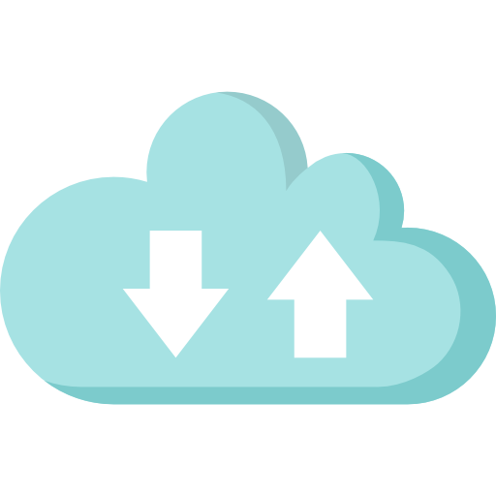




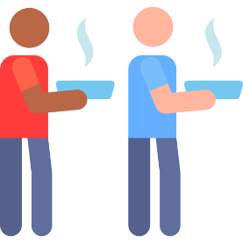
Key Characteristics of Cloud Computing
On-demand Self Service
Broad Network Access
Resource Pooling and Multi-tenancy
Scalability
Measured Service

Slide 5
Key Characteristics of Cloud Computing
On-Demand Access
Scalability
Broad Network Access
Users can access cloud-based services and resources whenever they need them, without the need for upfront infrastructure investments.
Cloud computing allows for seamless scaling of resources to meet changing demands, ensuring optimal performance and efficiency.
Cloud services can be accessed from any device with an internet connection, enabling remote work and collaboration.

Slide 6
Key Characteristics of Cloud Computing
Measured Service
Resource Pooling and Multi-tenancy
Cloud systems automatically control and optimize resource use by leveraging metering capabilities to monitor, measure, and report resource usage. This measurement facilitates transparent and optimized resource utilization while providing insights for billing, capacity planning, and performance optimization.
Cloud resources are shared among multiple users (multi-tenancy) while remaining dynamically assigned and reassigned based on demand. Physical and virtual resources are pooled to serve multiple consumers, allowing for cost efficiency and optimal resource utilization.

Slide 7

Benefits of Cloud Computing
Cost Savings
Increased Efficiency
Cloud computing eliminates the need for expensive on-premises hardware and software, reducing IT infrastructure costs.
The cloud's scalability and automated management allow businesses to focus on their core operations rather than IT maintenance.
Improved Collaboration
Enhanced Mobility
Cloud-based tools and platforms enable seamless collaboration among teams, regardless of their physical location.
Cloud computing enables access to data and applications from any device, anywhere, improving productivity and flexibility.

Slide 8
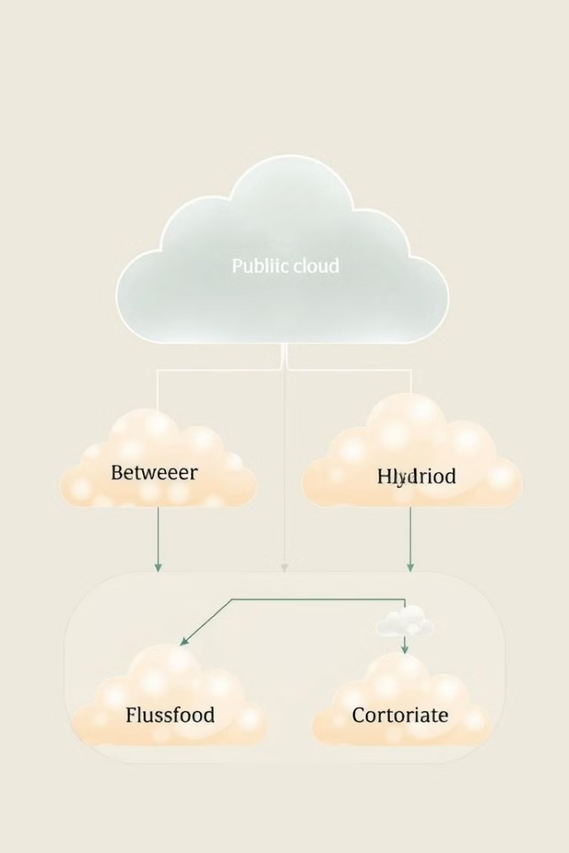
Types of Cloud Computing
1
Public Cloud
2
Private Cloud
Public cloud services are provided by third-party vendors and are available to the general public over the internet.
Private clouds are dedicated computing resources owned and managed by a single organization, offering greater control and security.
3
Hybrid Cloud
Hybrid cloud solutions combine public and private cloud resources, allowing organizations to leverage the benefits of both.

Slide 9

Public Cloud
Scalability
Cost-Effectiveness
Public clouds offer virtually limitless scalability, allowing organizations to easily expand or contract their computing resources as needed.
Public cloud services are typically priced on a pay-as-you-go model, eliminating the need for upfront infrastructure investments.
Shared Resources
Accessibility
Public clouds leverage shared computing resources, which can result in cost savings but may raise security and compliance concerns.
Public cloud services are accessible from any device with an internet connection, enabling remote work and collaboration.

Slide 10
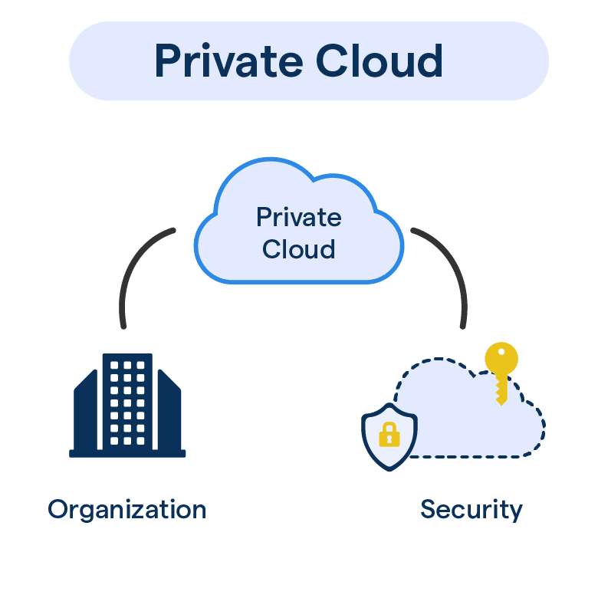
Private Cloud
Enhanced Control
Increased Security
Private clouds provide organizations with greater control over their computing resources, including data, security, and compliance.
Private clouds offer a higher level of data and infrastructure security, as the resources are dedicated to a single organization.
Customization
Private clouds can be tailored to an organization's specific needs, allowing for greater flexibility and optimization.

Slide 11
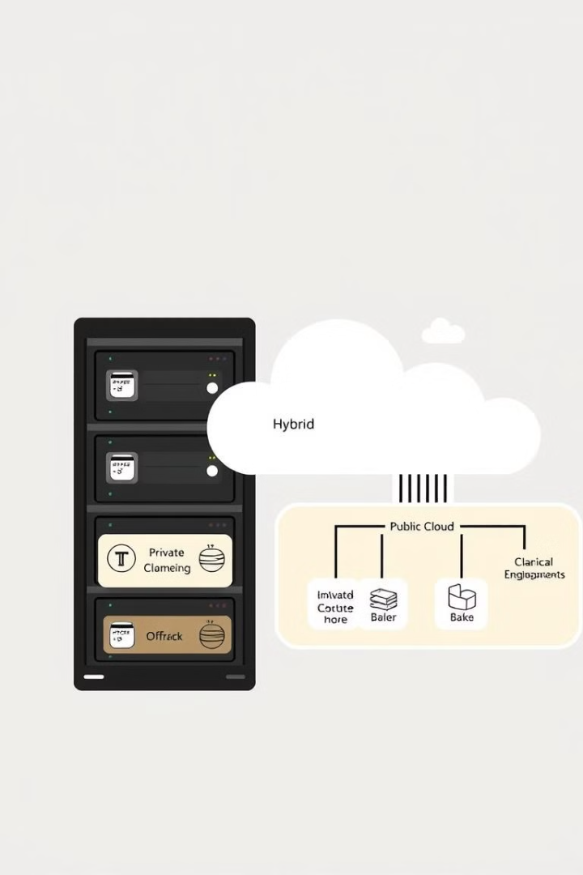
Hybrid Cloud
1
Flexibility
2
Workload Optimization
Hybrid clouds enable organizations to leverage the benefits of both public and private cloud environments, providing greater flexibility.
Hybrid clouds allow organizations to optimize their workloads by placing them in the most appropriate cloud environment.
3
Scalability
Hybrid clouds can scale resources up or down as needed, combining the scalability of public clouds with the control of private clouds.

Slide 12
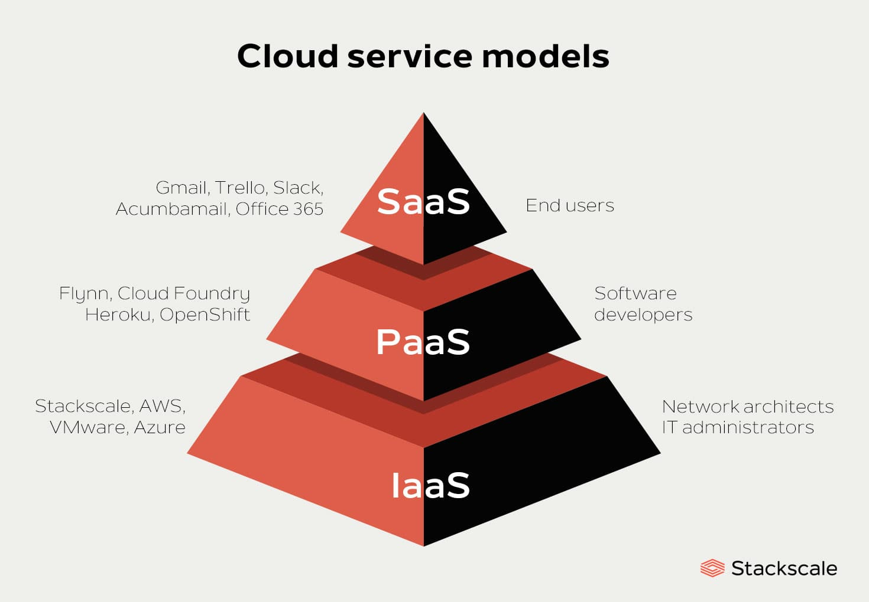
Cloud Service Models
A cloud service model refers to how cloud computing services are delivered to customers. These models define the types of services that are offered by cloud providers and the level of control, management, and responsibility given to the customer

Slide 13
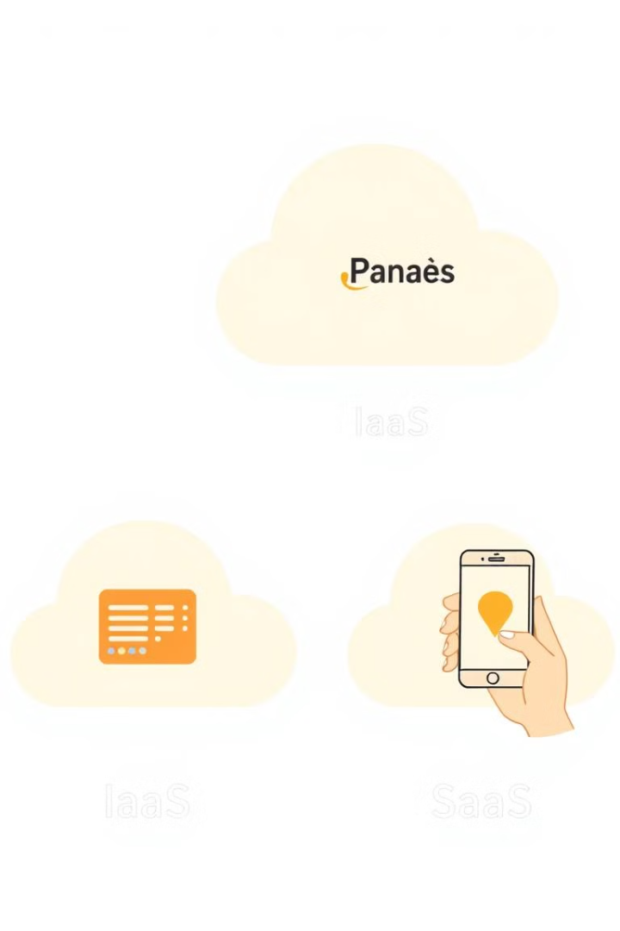



Cloud Service Models: IaaS, PaaS, SaaS
IaaS
Infrastructure-as-a-Service (IaaS) provides on-demand access to virtualized computing resources, including servers, storage, and networking.
PaaS
Platform-as-a-Service (PaaS) offers a complete platform for building, testing, and deploying applications, abstracting away infrastructure management.
SaaS
Software-as-a-Service (SaaS) delivers complete, ready-to-use software applications to users over the internet, eliminating the need for local installation and management.

Slide 14
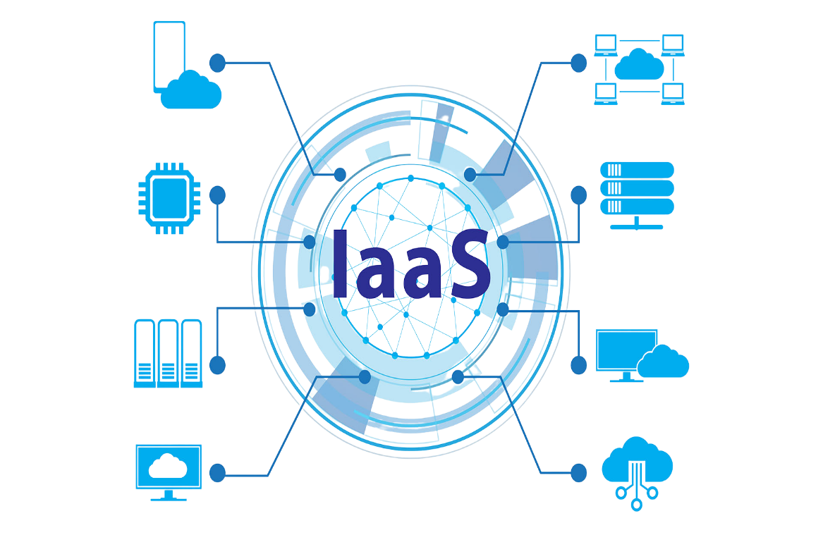
Infrastructure-as-a-Service (IaaS)
IaaS provides virtualized computing resources over the internet. These resources typically include servers, storage, and networking hardware.
Key Features
Full control over the infrastructure (e.g., you can choose operating systems, install software, etc.).
Pay-as-you-go model, where you only pay for what you use.
Examples
Amazon Web Services (AWS) EC2, Google Compute Engine (GCE), Microsoft Azure Virtual Machines.
Use Cases
Hosting websites, building and deploying custom applications, running virtual machines, disaster recovery, and data storage.

Slide 15
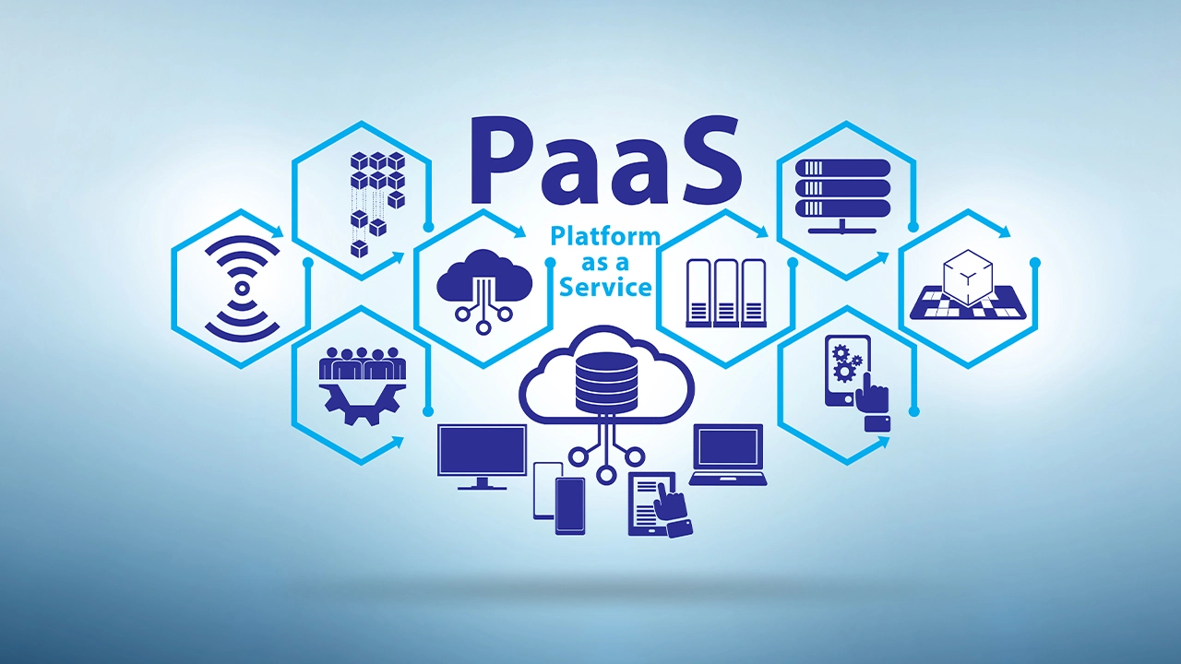
Palatiform-as-a-Service (IaaS)
PaaS provides a platform allowing customers to develop, run, and manage applications without dealing with the underlying infrastructure.
Key Features
Focus on development and deployment of applications.
The cloud provider manages the infrastructure (servers, storage, networking, etc.).
Provides tools for development, databases, and analytics.
Examples
Google App Engine, AWS Elastic Beanstalk, Microsoft Azure App Services.
Use Cases
Developing web and mobile applications, deploying microservices, building APIs, automating DevOps workflows.

Slide 16
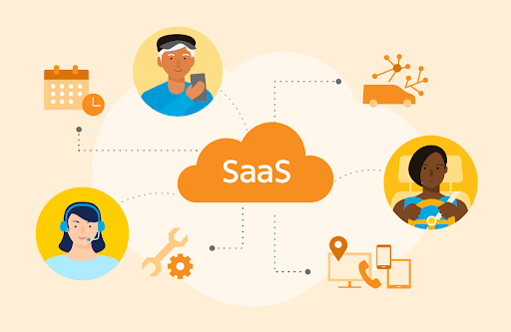
Software-as-a-Service (SaaS)
SaaS delivers fully functional applications via the internet, often on a subscription basis.
Key Features
End users access the software through a web browser or app, without worrying about underlying infrastructure.
The cloud provider manages everything (infrastructure, platforms, and applications).
Examples
Google Workspace (formerly G Suite), Microsoft 365, Salesforce, Dropbox.
Use Cases
Email services, customer relationship management (CRM), enterprise resource planning (ERP), document storage.

Slide 17
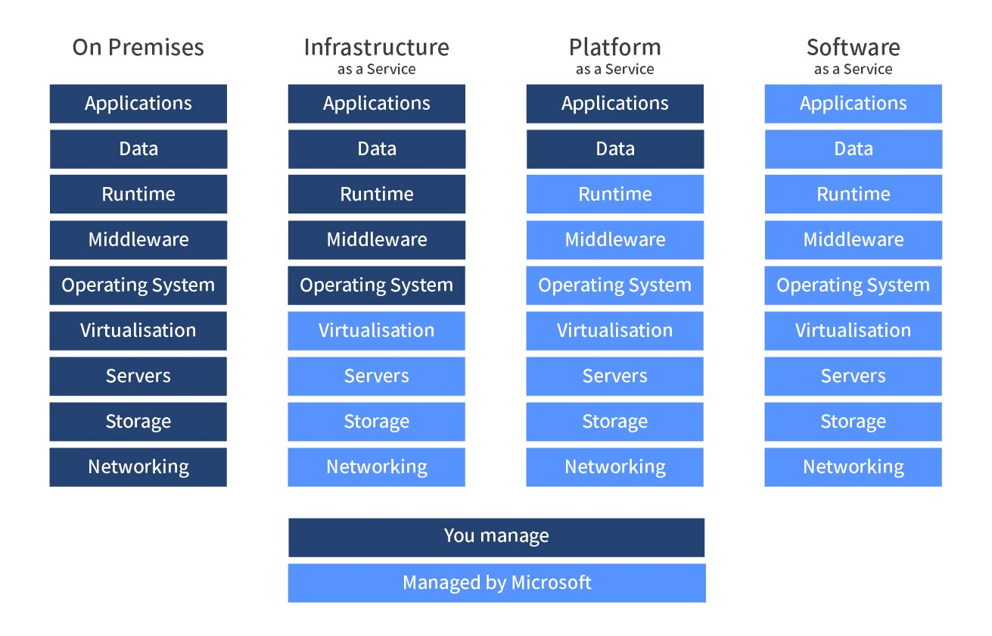
Responsibility- Who owns What

Slide 18
Microsoft Azure

Slide 19
Microsoft Azure Cloud
Microsoft Azure, formerly known as Windows Azure, is Microsoft's public cloud computing platform.
It provides a broad range of cloud services, including compute, analytics, storage and networking. Users can pick and choose from these services to develop and scale new applications or run existing applications in the public cloud.
Azure offers four different forms of cloud computing: infrastructure as a service (IaaS), platform as a service (PaaS), software as a service (SaaS) and serverless functions.
Microsoft charges for Azure on a pay-as-you-go (PAYG) basis, meaning subscribers receive a bill each month that only charges them for the specific resources and services they have used.
Microsoft unveiled Windows Azure in early October 2008 but it went to live after February 2010. Later in 2014, Microsoft changed its name from Windows Azure to Microsoft Azure.

Slide 20
Why Microsoft Azure?
Low Cost: Azure offers, pay as you go pricing. Azure models are usually cheapest among other service providers in the market.
Instant Elasticity: You need 1 server or 1000’s of servers, Azure has a massive infrastructure at backend to serve almost any kind of infrastructure demands, with pay for what you use policy.
Scalability: Facing some resource issues, no problem within seconds you can scale up the resources and improve your application performance. This cannot be compared with traditional IT datacenters.
Multiple OS’s: Choice and use any supported Operating systems.
Multiple Storage Options: Choice of high I/O storage, low cost storage. All is available in Azure, use and pay what you want to use with almost any scalability.

Slide 21
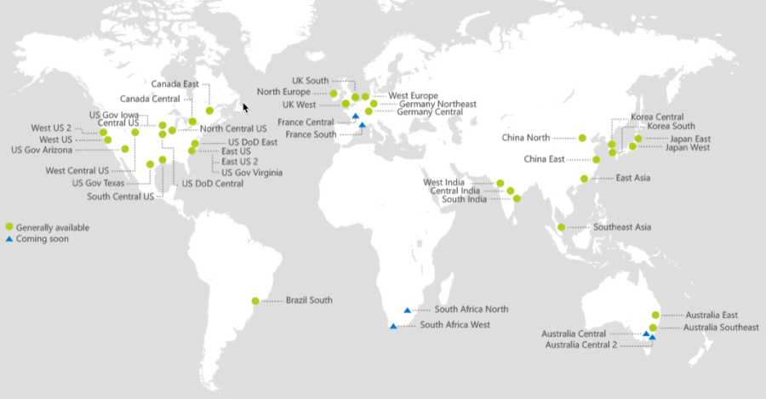
Azure Regions
Microsoft Azure is available in 60+ regions globally, with additional regions in the works to be added soon. These Azure Regions are basically geographic groupings of 2, 3, or more data centers.
When provisioning any cloud resource within Microsoft Azure it must be placed in, and reside within, an Azure Region.

Slide 22
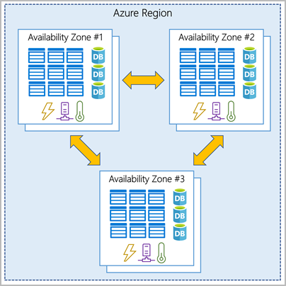
Azure Availability Zones
Availability Zones are multiple, isolated locations within each Region.
Azure Availability Zones are separate data center units within Microsoft Azure, each with its own power, cooling and networking. By running services on multiple availability zones, you can make your applications resilient to failure or disruption in your primary data center.

Slide 23
Azure Availability Set
An availability set is a logical grouping of virtual machines (VMs) that are deployed across multiple fault domains and update domains.
Each availability set can be configured with up to three fault domains and twenty update domains.
These configurations can't be changed once the availability set has been created.
Update domains indicate groups of virtual machines and underlying physical hardware that can be rebooted at the same time.
Fault domains define the group of virtual machines that share a common power source and network switch
The purpose of an availability set is to enhance the reliability and availability of applications and services by minimizing the impact of hardware or software failures and planned maintenance events.

Slide 24
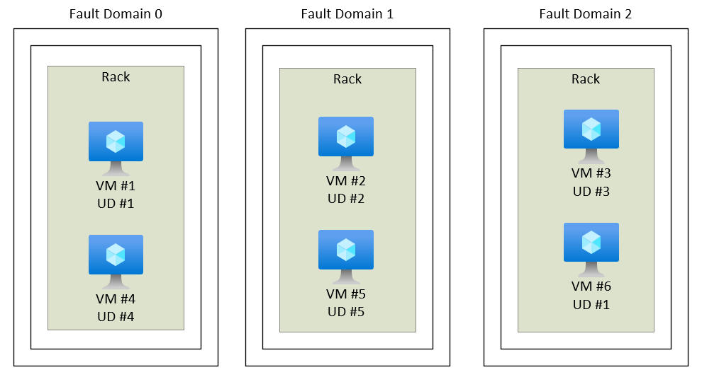
Azure Availability Set

Slide 25
Lab -1 Login to Azure Portal and Discover Azure Region and Availability Zone
Techlanders Solutions

Slide 26
Azure Active Directory
Techlanders Solutions

Slide 27
Azure Active Directory
Azure Active Directory (Azure AD) is a cloud-based identity and access management (IAM) service provided by Microsoft as part of its Azure cloud platform.
It is designed to help organizations manage user identities and control access to resources across various cloud applications, including Microsoft 365, Azure services, and other third-party applications.
Azure AD serves as a centralized repository for storing user accounts, security groups, and application information.
It enables administrators to manage user identities, assign access permissions, enforce security policies, and monitor user activity.

Slide 28
Azure Active Directory
Azure AD defines users in three ways
Cloud identities
Directory-synchronized
Guest users

Slide 29
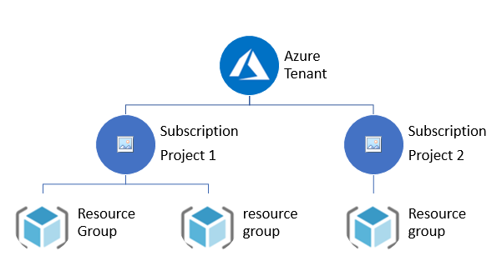
Tenant
A tenant is a representation of an organization. It's a dedicated instance of Azure AD that an organization or app developer receives when the organization or app developer creates a relationship with Microsoft-- like signing up for Azure, Microsoft Intune, or Microsoft 365.

Slide 30
Azure Subscriptions
Azure Subscriptions are a logical unit of Azure services that are linked to an Azure account.
An Azure subscription is linked to a single account, the one that was used to create the subscription and is used for billing purposes. Within the subscription, resources can be provisioned as instances of the many Azure products and services.
You can have more than one subscription, often for billing purposes, since each subscription generates its own set of billing reports and invoices.
The person who creates an Azure subscription becomes the global administrator for that subscription and has full access to every aspect of that subscription hence separate subscriptions can also be a way to create a division of responsibility for Azure services

Slide 31
Management Group
If your organization has many subscriptions, you may need a way to efficiently manage access, policies, and compliance for those subscriptions.
Azure management groups provide a level of scope above subscriptions.
You organize subscriptions into containers called "management groups" and apply your governance conditions to . the management groups.
All subscriptions within a management group automatically inherit the conditions applied to the managementgroup.
All subscriptions within a single management group must trust the same Azure Active Directory tenant.
For example, you can apply policies to a management group that limits the regions available for virtual machine (VM) creation. This policy would be applied to all management groups, subscriptions, and resources under that management group by only allowing VMs to be created in that region.
This security policy cannot be altered by the resource or subscription owner allowing for improved governance.

Slide 32
Resource Group
A resource group is a container that holds related resources for an Azure solution. The resource group can include all the resources for the solution, or only those resources that you want to manage as a group.
The resource group stores metadata about the resources. Therefore, when you specify a location for the resource group, you are specifying where that metadata is stored. For compliance reasons, you may need to ensure that your data is stored in a particular region.

Slide 33
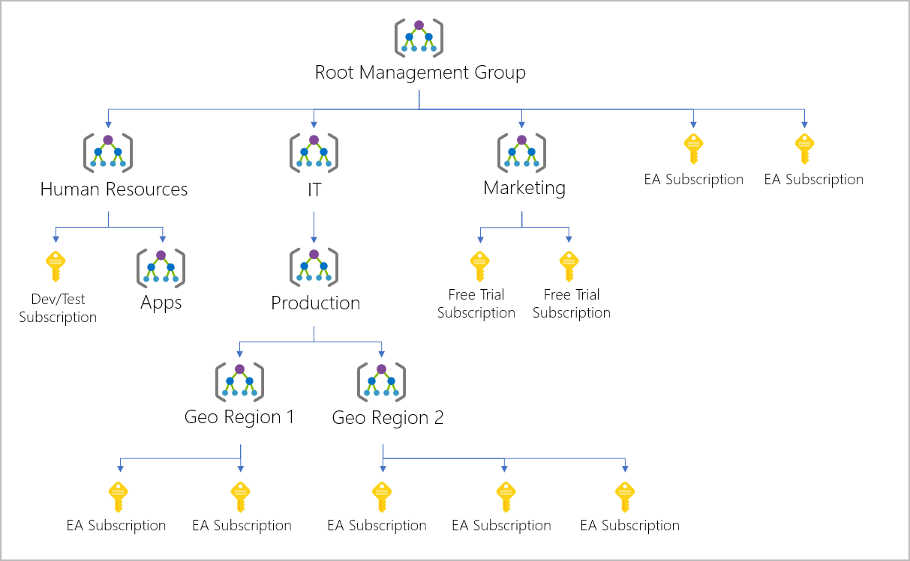
Management Group , Subscription and Resource Group

Slide 34
Important facts about management groups
10,000 management groups can be supported in a single directory.
A management group tree can support up to six levels of depth.
This limit doesn't include the Root level or the subscription level.
Each management group and subscription can only support one parent.
Each management group can have many children.

Slide 35
Root management group for each directory
Each directory is given a single top-level management group called the "Root" management group.
This root management group is built into the hierarchy to have all management groups and subscriptions fold up to it.
By default, the root management group's display name is Tenant root group.
To change the display name, your account must be assigned the Owner or Contributor role on the root management group.
No one is given default access to the root management group. Azure AD Global Administrators are the only users that can elevate themselves to gain access.
Once they have access to the root management group, the global administrators can assign any Azure role to other users to manage it.

Slide 36
Azure Policy
Azure Policy is a service provided by Microsoft Azure that allows you to enforce and implement governance policies for your Azure resources.
Azure Policy helps you to define and enforce rules and standards for resource configuration and compliance across your Azure environment.
Azure Policy allows you to create policy definitions that express your organization's requirements and expectations for the Azure resources deployed within your subscription.
These policy definitions are based on JSON files and contain rules that define the desired configuration for resources, such as virtual machines, storage accounts, networking, and more.

Slide 37
Azure Policy
Some key features and capabilities of Azure Policy include:
Policy Definition
Policy Assignment
Compliance Monitoring
Remediation
Integration with Azure Resource Manager
Policy Exemptions

Slide 38
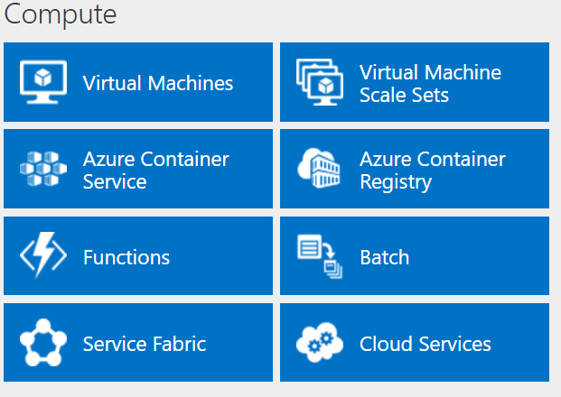
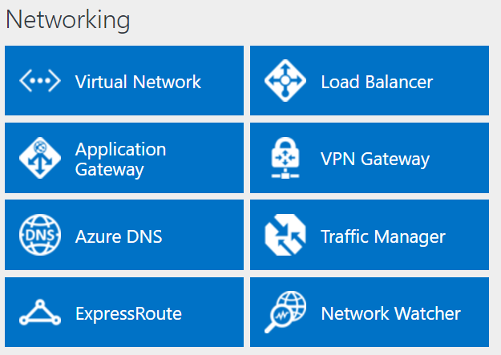
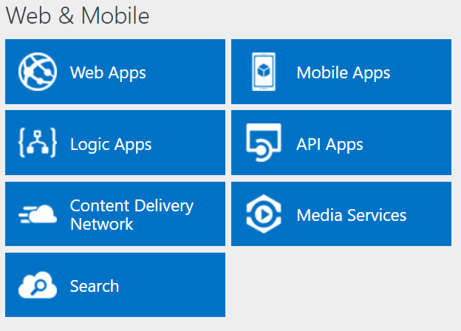
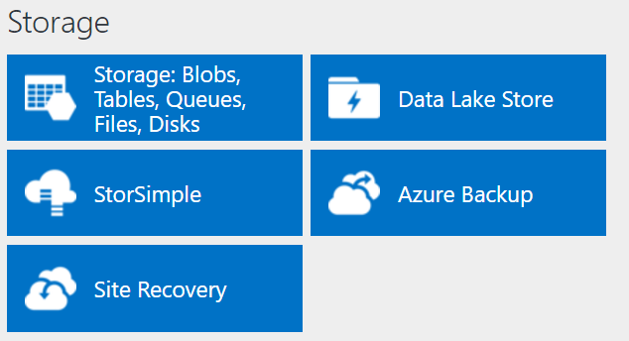
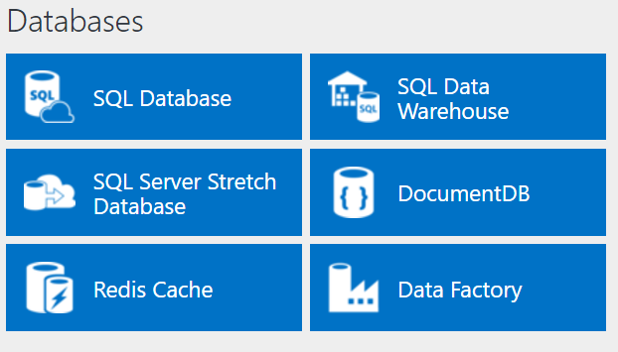
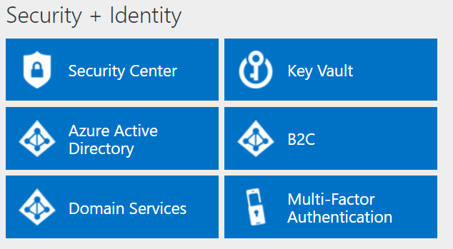
Services Offered

Slide 39
Microsoft Azure VMs
An Azure virtual machine gives you the flexibility of virtualization without having to buy and maintain the physical hardware that runs it. However, you still need to maintain the virtual machine by performing tasks, such as configuring, patching, and installing the software that runs on it.

Slide 40
Azure VM
Azure Virtual Machines supports the deployment of Windows or Linux virtual machines (VMs) in a Microsoft Azure datacenter.
You have total control over the configuration of the VM. You are responsible for all server software installation, configuration, and maintenance and for operating system patches.
Because of the level of control afforded to the user and the use of durable disks, VMs are ideal for a wide range of server workloads that do not fit into a PaaS model.
Microsoft offers a 99.95 percent connectivity service level agreement (SLA) for multiple-instance VMs deployed. That means that for the SLA to apply, there must be at least two instances of the VM deployed within an availability set.

Slide 41
Azure VM
Azure Virtual Machines is priced on a per-hour basis, but it is billed on a per-minute basis. For example, you are only charged for 23 minutes of usage if the VM is deployed for 23 minutes.
The cost for a VM includes the charge for the Windows operating system. Linux-based instances are slightly cheaper because there is no operating system license charge.
The cost, and the appropriate licensing, for any additional software you install is your responsibility.
Some VM images, such as Microsoft SQL Server, you acquire from the Azure Marketplace may include an additional license cost (on top of the base cost of the VM).

Slide 42
Lab -2 CREATE VIRTUAL MACHINES

Slide 43
Azure PowerShell

Slide 44
Azure PowerShell
Azure PowerShell is a command-line interface (CLI) tool that allows users to manage and automate Azure resources using PowerShell scripting language.
It provides a set of cmdlets (commands) specifically designed to interact with Azure services and resources.
Azure PowerShell interacts with the Azure management API to execute commands and manage resources.
It can be installed as a module within PowerShell and provides a consistent and intuitive way to manage Azure resources across different Azure services.

Slide 45
Azure PowerShell
Some common tasks you can perform with Azure PowerShell include:
Creating and managing Azure virtual machines
Managing Azure storage accounts and blobs
Configuring Azure virtual networks and subnets
Deploying and managing Azure resource groups
Managing Azure Active Directory resources
Configuring and managing Azure App Services
Managing Azure SQL databases and other data services

Slide 46
Lab -3 Installing/Updating PowerShell Az Module

Slide 47
Session 3
Azure Storage Service

Slide 48
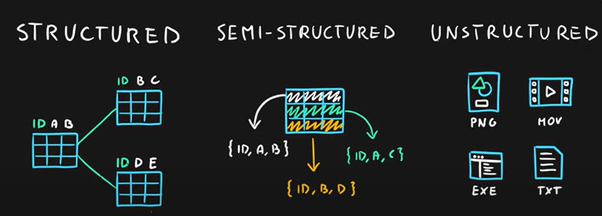
Types of Data

Slide 49
Azure Storage Service
Azure Storage, managed by Microsoft, is one of the top cloud storage services that provide reliable and simplified storage services.
Azure Storage offers storage services that are enormously scalable, accessible, and durable.
The storage services include storage structures for data objects, disks for virtual machines, message storage for messaging and communication, file storage for cloud-based and on-site file systems, and NoSQL storage.

Slide 50
Azure Storage Account Types
Azure Storage offers two kinds of storage services to its customers:
Standard Storage
Premium Storage.

Slide 51
Standard Storage Account
The standard plan includes –
Blob
Table
File
Queue storage.
Let's have a look at each one in detail to understand the primary differences.

Slide 52
Blob Storage
The first type of storage facility is Blob Storage.
Blob Storage refers to storage for unstructured data.
This type of data could include videos, images, audio files, raw data, logs, and documents.
users can also store backup data.
Similar to AWS S3, the data in Blob Storage is stored in a directory structure known as “Container”.
The maximum size of the blob is 500 TB. Blob Storage consists of three kinds of blobs: block, append, and backup blobs.

Slide 53
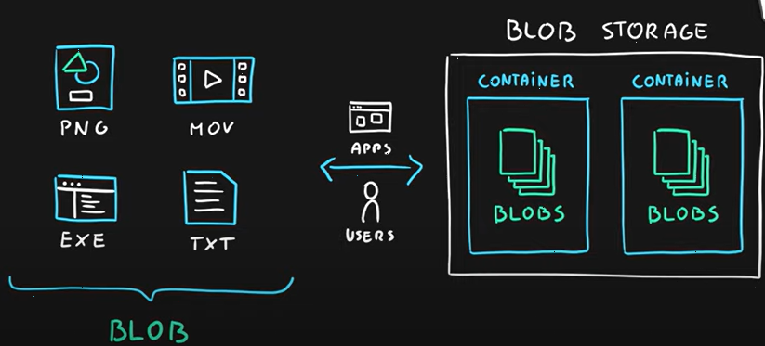
Blob Storage

Slide 54
Lab -4 CREATE STORAGE ACCOUNT

Slide 55
Lab -5 CREATE A BLOB INSIDE STORAGE ACCOUNT AND UPLAOD A FILE

Slide 56
File Storage
Azure File Storage is a storage service meant for legacy applications and data.
It is an organized storage structure the enables file sharing across the cloud for on-premise environments. Azure VMs access Azure File storage to share their data.
On the other hand, on-premise applications access the Azure File storage using REST API.

Slide 57
Lab -6 CREATE A FILE STORAGE AND SHARE DATA IN BETWEEN VIRTUAL MACHINES

Slide 58
Table and Queue Storage
Table Storage: Azure Tables, as the name implies, refers to the tabular data structure. This kind of structure is suitable for the data in key-value pairs. Azure Tables are easy to use and provide scalability to a massive level. Using the REST API, the data stored in the tables can be accessed easily.
Queue Storage: The last type of storage service for Standard Account is Queue Storage. This service is mostly suitable for exchanging messages and facilitating communication between various Azure components. These components could be on Azure cloud or on-premise. The messages are communicated via HTTP or HTTPS protocol.

Slide 59
Microsoft Azure Data Lake Gen2 Account
Azure Data Lake Storage Gen2 is a set of capabilities dedicated to big data analytics, built on Azure Blob Storage.
Data Lake Storage Gen2 converges the capabilities of Azure Data Lake Storage Gen1 with Azure Blob Storage. For example, Data Lake Storage Gen2 provides file system semantics, file-level security, and scale. Because these capabilities are built on Blob storage, you'll also get low-cost, tiered storage, with high availability/disaster recovery capabilities.
https://learn.microsoft.com/en-us/azure/storage/blobs/data-lake-storage-introduction
Techlanders Solutions

Slide 60
Lab -7 CREATE AZURE DATA LAKE ACCOUNT

Slide 61
Microsoft AZ-104 Exam Actual Questions
Your company has serval departments. Each department has a number of virtual machines (VMs). The company has an Azure subscription that contains a resource group named RG1.
All VMs are located in RG1.
You want to associate each VM with its respective department.
What should you do?
A. Create Azure Management Groups for each department.
B. Create a resource group for each department.
C. Assign tags to the virtual machines.
D. Modify the settings of the virtual machines.
ANS: Assign tags to the virtual machines.
Techlanders Solutions

Slide 62
Microsoft AZ-104 Exam Actual Questions
Your company has an Azure Active Directory (Azure AD) subscription.
You want to implement an Azure AD conditional access policy.
The policy must be configured to require members of the Global Administrators group to use Multi-Factor Authentication and an Azure AD-joined device when they connect to Azure AD from untrusted locations.
Solution: You access the multi-factor authentication page to alter the user settings.
Does the solution meet the goal?
A. Yes
B. No
ANS : B
Techlanders Solutions

Slide 63
Microsoft AZ-104 Exam Actual Questions
Your company has an Azure Active Directory (Azure AD) subscription.
You want to implement an Azure AD conditional access policy.
The policy must be configured to require members of the Global Administrators group to use Multi-Factor Authentication and an Azure AD-joined device when they connect to Azure AD from untrusted locations.
Solution: You access the Azure portal to alter the grant control of the Azure AD conditional access policy.
Does the solution meet the goal?
A. Yes
B. No
ANS : A
Techlanders Solutions

Slide 64
Microsoft AZ-104 Exam Actual Questions
You are planning to deploy an Ubuntu Server virtual machine to your company's Azure subscription.
You are required to implement a custom deployment that includes adding a particular trusted root certification authority (CA).
Which of the following should you use to create the virtual machine?
A. The New-AzureRmVm cmdlet.
B. The New-AzVM cmdlet.
C. The Create-AzVM cmdlet.
D. The az vm create command
ANS : The az vm create command.
Techlanders Solutions

Slide 65
Microsoft AZ-104 Exam Actual Questions
Your company has a Microsoft Azure subscription. The company has datacenters in Los Angeles and New York.
You are configuring the two datacenters as geo-clustered sites for site resiliency. You need to recommend an Azure storage redundancy option. You have the following data storage requirements:
✑ Data must be stored on multiple nodes.
✑ Data must be stored on nodes in separate geographic locations.
✑ Data can be read from the secondary location as well as from the primary location.
Which of the following Azure stored redundancy options should you recommend?
A. Geo-redundant storage
B. Read-only geo-redundant storage
C. Zone-redundant storage
D. Locally redundant storage
ANS : Read-only geo-redundant storage
Techlanders Solutions

Slide 66
Microsoft AZ-104 Exam Actual Questions
av
Techlanders Solutions

Slide 67
Azure RDS Services

Slide 68
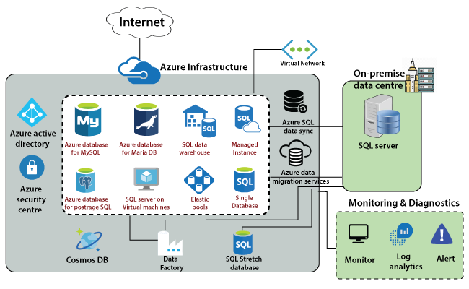
Azure Database Services
Azure SQL/NoSQL databases are one of the basic and fundamental building blocks offered by Microsoft Azure as part of its fully managed services.
Azure provides various SQL/NoSQL servers and traditional SQL database tools to make database migration simple, guided and automated with a single click from the Azure portal. Users can simply deploy one or more databases to virtual machines or apps as part of Azure’s shared elastic pools by using various database services.

Slide 69
Azure Database Services
Microsoft Azure Database is a fully managed database platform that can be used as a platform as a service (Paas) to monitor and manage database functions such as backups, patches, and upgrades automatically.
It reduces user intervention and allows customers to manage their data more easily on-premise or in virtual machines.
Users may quickly migrate their SQL databases from various on-premises and machines to SQL without any difficult configuration and manage the moved instance thanks to Azure’s global data centers.
Microsoft’s Azure infrastructure includes databases such as MySQL, PostgreSQL, and Elastic Pool.
Azure also maintains SQL Server on virtual machines and SQL data warehouse in its managed platform on Azure as part of database services, as well as MariaDB and Cosmos DB

Slide 70
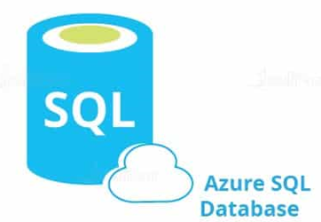
Azure SQL Database
Microsoft Azure SQL Database is a relational database-as-a-service that is reliable and secure, and it gives high performance without having to worry about any infrastructure. It supports relational, JSON, XML, and spatial data structures.

Slide 71
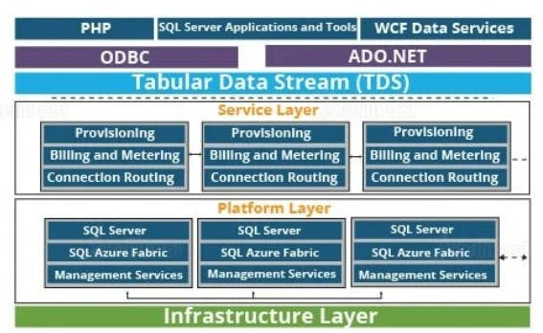
SQL Azure Architecture
Microsoft Azure SQL Database is a relational database-as-a-service that is reliable and secure, and it gives high performance without having to worry about any infrastructure. It supports relational, JSON, XML, and spatial data structures.

Slide 72
Lab -10 Configure MS-SQL Database

Slide 73
Azure Cosmos DB

Slide 74
Azure Cosmos Database
It’s a NoSQL database that Azure uses to store structured, unstructured, and semi-structured data.
The Azure Cosmos database is highly available (99.999%), dynamically scalable, and has very low latency for loading and retrieving data.
The Cosmos database aids in the management of real-time data with massive changes that are controlled using big data technology.
Users can enable the cosmos database service with a single button and save data across global areas, making it a globally distributed and multi-modal database.
Because it is a NoSQL database, it does not require schema or index management because the database engine manages the schema automatically.
As a result, there is no application downtime because Cosmos DB indexes the data automatically. It features built-in security, and by default, all data is encrypted.

Slide 75
Azure Cosmos Database
Cosmos DB has the following use cases:
IoT and Telematics: Enables real-time data and processing bursts.
Retail and Marketing: Data and event sources from catalogs are supported.
Gaming: Low-latency needs, massive request bursts, and social graphs are all supported.
Web and Mobile Applications: Supports sophisticated data types and flexible schema, which are required for social applications and personalization.

Slide 76
Lab : Configure Cosmos Database

Slide 77
Azure Virtual Network

Slide 78
Azure Virtual Network
The Azure Virtual Network is a logical representation of the network in the cloud. So, by creating an Azure Virtual Network, we can define our private IP address range on Azure, and also deploy different kinds of Azure resources. For Example - Azure virtual machine, App service environment, Integration service environment, etc.

Slide 79
Azure Virtual Network Components
Subnets
IP addresses
Network Security Groups (NSG)
Firewall
Load balancing
Routing tables

Slide 80
Lab : Create a Virtual Network

Slide 81
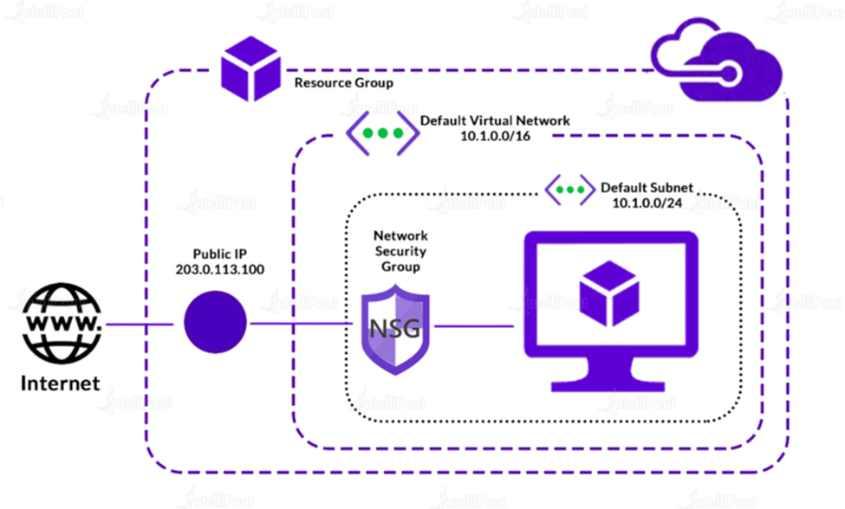
Azure Network Security Group
A network security group contains security rules that allow or deny inbound network traffic to, or outbound network traffic from, several types of Azure resources. For each rule, you can specify source and destination, port, and protocol.

Slide 82
Azure Network Security Group
Some key features and capabilities of Azure Network Security Groups:
Traffic filtering:
Subnet and resource-level security
Prioritization of rules
Application security groups
Logging and monitoring
Integration with other Azure services

Slide 83
Azure Network Connectivity
Site-to-Site VPN connections
Point-to-Site VPN connections
VNet-to-VNet VPN connections

Slide 84
VNet-to-VNet VPN connections
Local VNet-to-VNet Peering : VNet can connect to each others in same region
Peering can be done in same subscription in same tenant in same region
Peering can be done in different subscription in same tenant in same region
Peering can be done in different subscription in different tenant in same region.
Global VNet-to-VNet Peering : With Global VNet Peering available, you can enable connectivity across all Azure public regions without additional bandwidth restrictions and as always keeping all your traffic on the Microsoft Backbone.
Peering can be done in same subscription in same tenant in different region
Peering can be done in different subscription in same tenant in different region
Peering can be done in different subscription in different tenant in different region

Slide 85
Lab : Local & Global VNet-to-VNet Peering

Slide 86
Point-to-Site connections
A Point-to-Site (P2S) VPN connection helps to create a secure connection tunnel to your virtual network (VNet) from an individual client computer device.
P2S VPN is established by initiating it from the client’s computer device. This solution is useful for WFH (Work From Home) employees who want to connect to Azure VNets from a remote location.
P2S VPN is also a useful solution to use in place of S2S VPN when you have only a few clients that want to connect to a VNet.
In point-to-site, you have to connect to the network you want to access manually. Usually, if you log-off or restart the workstation it loses connection, and you have to reconnect every time. It's common to use this type of VPN when we are working remotely, and we need to access our company assets.

Slide 87
Lab : Point-to-Site Connections

Slide 88
Lab : Point-to-Site Connections
Create a VNet
Create a gateway Subnet in subnet
Create Virtual Network gateway in same Region
Create Self signed root and client certificate
#self signed root certificate
$cert = New-SelfSignedCertificate -Type Custom -KeySpec Signature ` -Subject "CN=P2SRootCert" -KeyExportPolicy Exportable ` -HashAlgorithm sha256 -KeyLength 2048 ` -CertStoreLocation "Cert:\CurrentUser\My" -KeyUsageProperty Sign -KeyUsage CertSign
#client side cerfiticate
New-SelfSignedCertificate -Type Custom -DnsName P2SChildCert -KeySpec Signature ` -Subject "CN=P2SChildCert" -KeyExportPolicy Exportable ` -HashAlgorithm sha256 -KeyLength 2048 ` -CertStoreLocation "Cert:\CurrentUser\My" ` -Signer $cert -TextExtension @("2.5.29.37={text}1.3.6.1.5.5.7.3.2")
5.

Slide 89
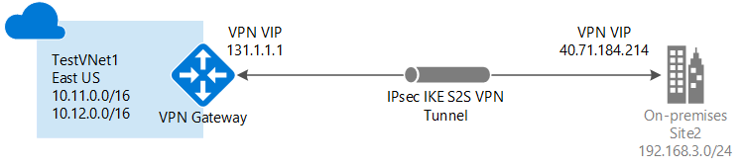
Site-to-Site connections
A Site-to-Site VPN gateway connection is used to connect your on-premises network to an Azure virtual network over an IPsec VPN tunnel.
This type of connection requires a VPN device located on-premises that has an externally facing public IP address assigned to it.
Site-to-site is used when you want to connect two networks and keep the communication up all the time. It's also bi-directional, but it's many-to-many and stays up no matter if your server/workstation is running or not because the connection is established through a network gateway and not from the computer operating system.

Slide 90
Site-to-Site VPN connections
There are two types of Site-to-Site VPN
Policy-based VPN devices use the combinations of prefixes from both networks to define how traffic is encrypted/decrypted through IPsec tunnels. It is typically built on firewall devices that perform packet filtering. IPsec tunnel encryption and decryption are added to the packet filtering and processing engine.
Route-based VPN devices use any-to-any (wildcard) traffic selectors, and let routing/forwarding tables direct traffic to different IPsec tunnels. It is typically built on router platforms where each IPsec tunnel is modeled as a network interface or VTI (virtual tunnel interface).

Slide 91
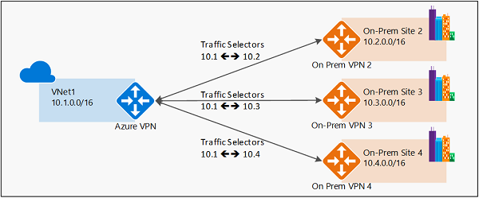
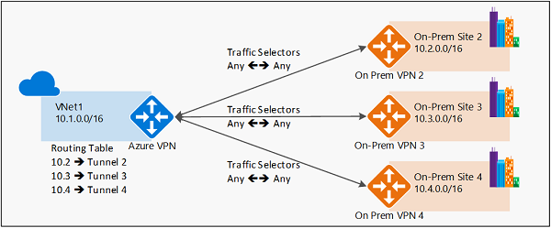
Site-to-Site VPN connections
Policy-based VPN Route-based VPN

Slide 92
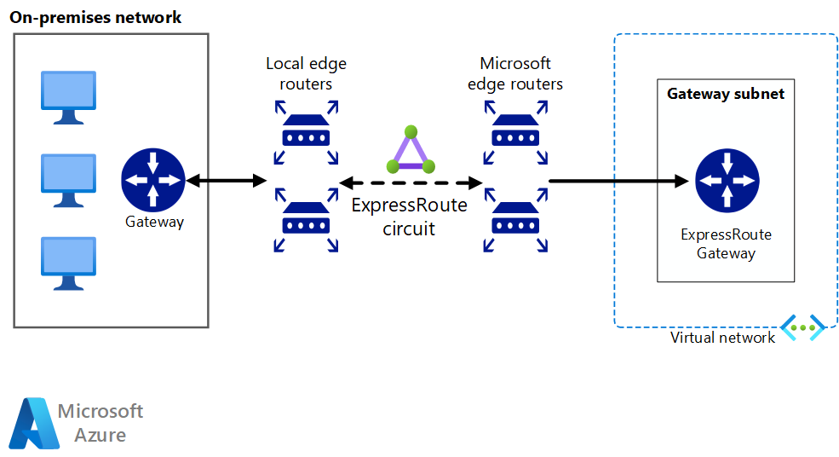
Azure Express Route
ExpressRoute is an Azure service that lets you create private connections between Microsoft datacenters and infrastructure that's on your premises or in a colocation facility.
ExpressRoute connections don't go over the public Internet, and offer higher security, reliability, and speeds with lower latencies than typical connections over the Internet.

Slide 93
Azure Bastion
Azure Bastion is a fully managed service that provides more secure and seamless Remote Desktop Protocol (RDP) and Secure Shell Protocol (SSH) access to virtual machines (VMs) without any exposure through public IP addresses.
Secure and seamless RDP and SSH access to your virtual machines.
No Public IP exposure on the VM.
Help limit threats such as port scanning and other types of malware targeting your VMs.
Uses a modern HTML5-based web client and standard SSL ports. This makes Firewall and other security rules very easy to manage.
Fixed charge for the service. This is the charge billed hourly for deploying the service. E.g. in an East US location, this charge is around $0.19 per hour.

Slide 94
Lab : Create a Azure Bastion Services

Slide 95
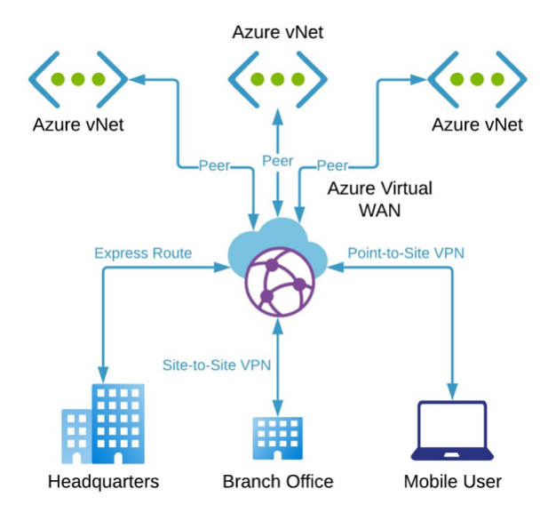
Virtual WAN
Azure Virtual WAN is a networking service that brings many networking, security, and routing functionalities together to provide a single operational interface. Some of the main features include:
Branch connectivity (via connectivity automation from Virtual WAN Partner devices such as SD-WAN or VPN CPE).
Site-to-site VPN connectivity.
Remote user VPN connectivity (point-to-site).
Private connectivity (ExpressRoute).
Intra-cloud connectivity (transitive connectivity for virtual networks).
VPN ExpressRoute inter-connectivity.
Routing, Azure Firewall, and encryption for private connectivity.

Slide 96
Lab : Create a Azure WAN Services

Slide 97
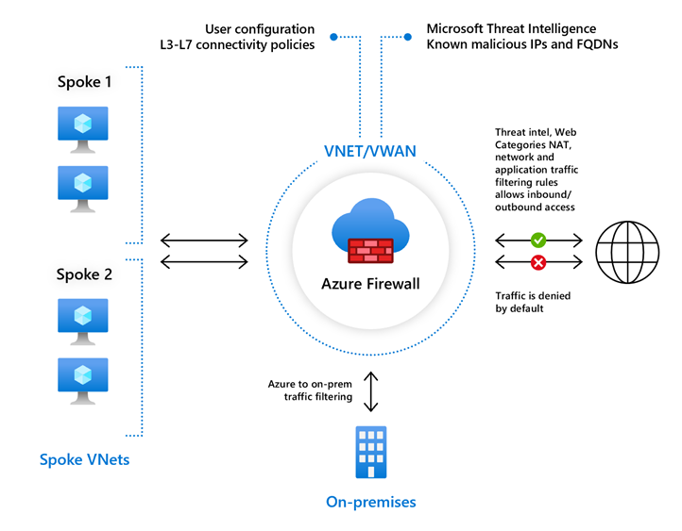
Azure Firewall
Azure Firewall is a cloud-based network security service provided by Microsoft Azure.
It acts as a barrier between your Azure virtual networks and the internet, allowing you to control and inspect network traffic that flows in and out of your virtual networks.

Slide 98
Azure Firewall
Azure Firewall operates at the network and application layers, providing advanced filtering and threat protection capabilities.
It offers the following features:
Network filtering
Application-level filtering
Threat intelligence-based filtering.
Outbound connectivity
High availability and scalability
Integration with Azure services

Slide 99
Lab : Create a Azure Firewall Services

Slide 100
Azure Services Endpoint
Azure Services Endpoint is a feature in Microsoft Azure that allows you to securely access and consume Azure services privately from within your virtual network.
It provides a private and direct connection to specific Azure services without the need for public internet connectivity.
Endpoints allow you to secure your critical Azure service resources to only your virtual networks.
Service Endpoints enables private IP addresses in the VNet to reach the endpoint of an Azure service without needing a public IP address on the VNet.

Slide 101
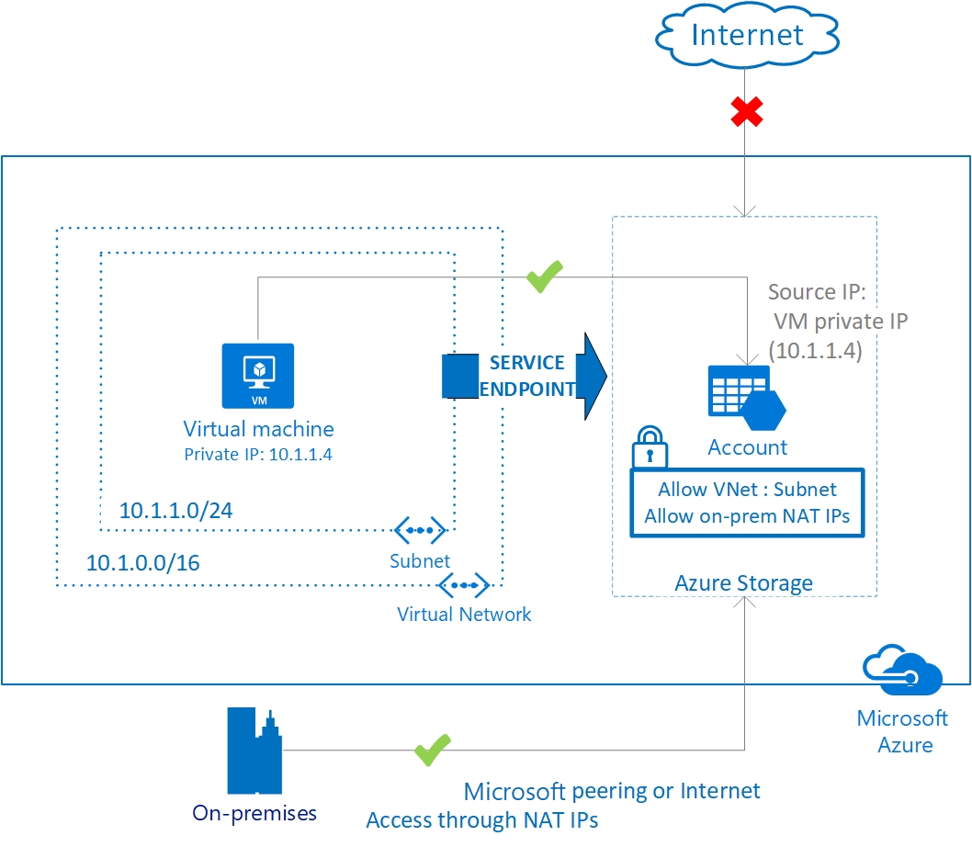
Azure Services Endpoint

Slide 102
Lab : Services Endpoint

Slide 103
Azure Load Balancer

Slide 104
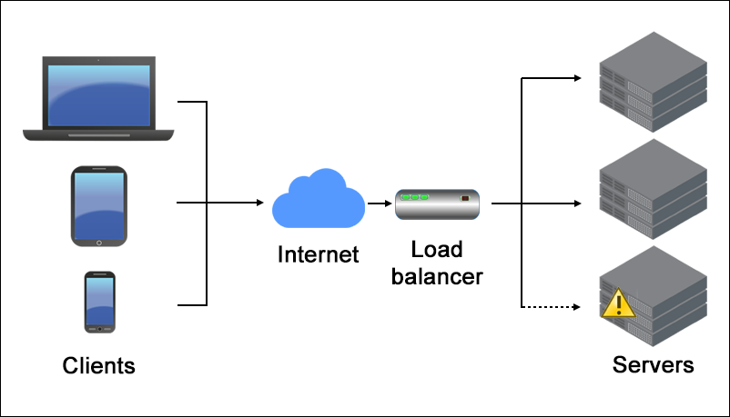
Azure load balancer
Azure load balancer allows you to distribute traffic to your backend virtual machines.
An Azure load balancer provides high availability for your application.
The Azure load balancer is a fully managed service itself.
A load balancer provides low latency and high throughput and scales up to millions of flows for all TCP and UDP applications.
Azure Load Balancer operates at layer 4 of the Open Systems Interconnection (OSI) model.

Slide 105
Azure load balancer
Key scenarios that you can accomplish using Azure Standard Load Balancer include:
Load balance internal and external traffic to Azure virtual machines.
Increase availability by distributing resources within and across zones.
Configure outbound connectivity for Azure virtual machines.
Use health probes to monitor load-balanced resources.
Employ port forwarding to access virtual machines in a virtual network by public IP address and port.
Enable support for load-balancing of IPv6.
Load balance services on multiple ports, multiple IP addresses, or both.
Move internal and external load balancer resources across Azure regions.
Load balance TCP and UDP flow on all ports simultaneously using HA ports.
Chain Standard Load Balancer and Gateway Load Balancer.

Slide 106
Types of Load Balancer
In Azure, you can create two types of the load balancer
Public load balancer
Internal/ private load balancer

Slide 107
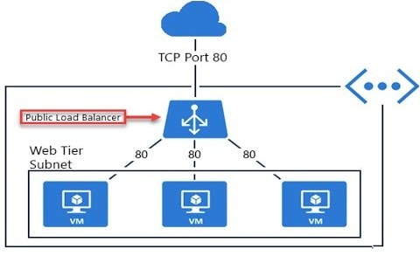
Public load balancer
A public load balancer can be used to load balance internet traffic to virtual machines. It can provide outbound connections for virtual machines (VMs) inside your virtual network.

Slide 108
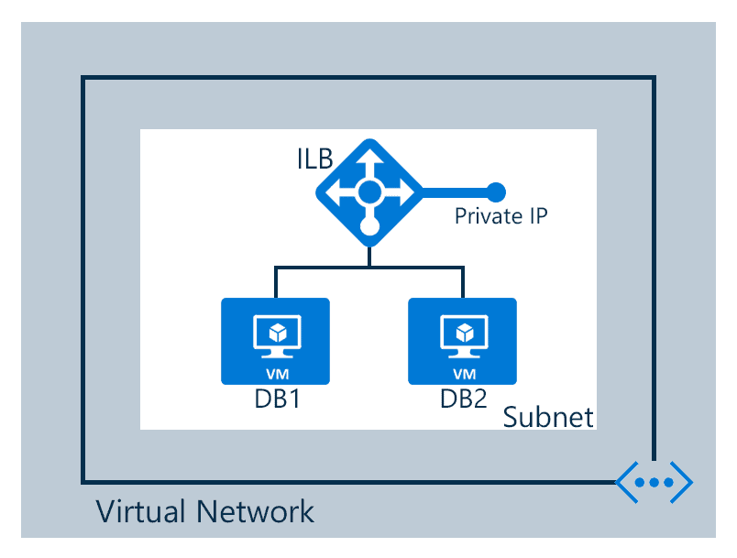
Internal load balancer
An internal (or private) load balancer is used to balance traffic from within a virtual network.

Slide 109
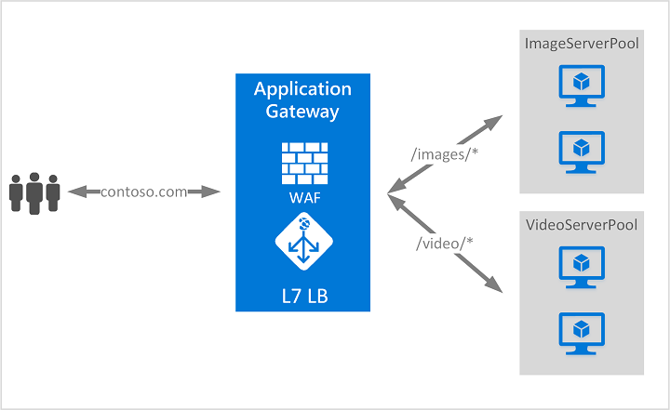
Application Gateway
Azure Application Gateway is a Layer 7 (Application Layer) load balancer that is specifically designed for handling HTTP and HTTPS traffic. It acts as an Application Delivery Controller (ADC) and provides advanced routing capabilities beyond just distributing traffic.

Slide 110
Azure Monitoring & Logging

Slide 111
Microsoft Azure Monitor
Microsoft Azure Monitor is a tool that collects and analyzes data about the various Azure resources and the infrastructure on which these resources are run. Azure Monitor offers a one stop solution to store and analyze data about the working of various resources.

Slide 112
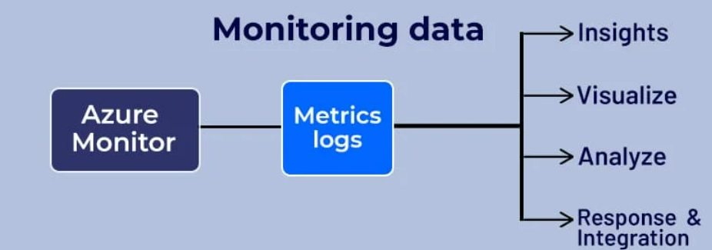
How Microsoft Azure Monitor Work

Slide 113
Lab : Azure Monitor

Slide 114
Serverless Computing

Slide 115
Serverless computing
Serverless computing enables developers to build applications faster by eliminating the need for them to manage infrastructure.
With serverless applications, the cloud service provider automatically provisions, scales, and manages the infrastructure required to run the code.

Slide 116
Top benefits of serverless computing
No infrastructure management : Using fully managed services enables developers to avoid administrative tasks and focus on core business logic. With a serverless platform, you simply deploy your code, and it runs with high availability.
Dynamic scalability : With serverless computing, the infrastructure dynamically scales up and down within seconds to match the demands of any workload.
Faster time to market : Serverless applications reduce the operations dependencies on each development cycle, increasing development teams’ agility to deliver more functionality in less time.
More efficient use of resources : Shifting to serverless technologies helps organizations reduce TCO and reallocate resources to accelerate the pace of innovation.

Slide 117
App Service
App Service is a Platform as a Service (PaaS) offering from Microsoft.
Azure App Services provide a hosting service that developers can use to develop mobile or web apps.
Azure Web Apps provides a platform to build an app in Azure without having to deploy, configure and maintain your own Azure VM’s.
You can build Web App using the ASP.NET, PHP, Node.js and Python.
They also integrate common development environments like Visual Studio and GitHub.
You need to pay for the Azure compute resources you use.

Slide 118
Azure Web Apps Features
Multiple Languages and Frameworks
Global Scale and Availability
Easy Deployment
Security and Compliance.
Visual Studio Integration.
API and Mobile Features.
Serverless Code
Managed Production Environment
Application Templates

Slide 119
Azure Data Factory

Slide 120
Azure Data Factory
It is the cloud-based ETL and data integration service that allows you to create data-driven workflows for orchestrating data movement and transforming data at scale.
Using Azure Data Factory, you can create and schedule data-driven workflows (called pipelines) that can ingest data from disparate data stores.
You can build complex ETL processes that transform data visually with data flows or by using compute services such as Azure HDInsight Hadoop, Azure Databricks, and Azure SQL Database.

Slide 121
ETL
ETL stands for "extract, transform, and load". It's a data integration process that involves moving data from multiple sources into a single repository, such as a data warehouse or data lake. The process is used to clean, organize, and prepare data for storage, analysis, and machine learning.
Here are the three steps of the ETL process:
Extract: Collect data from one or more sources and temporarily store it. Validation rules are applied to ensure the data meets the requirements of its destination.
Transform: Process the data to make it conform to a uniform schema. This can involve aggregators, data masking, expression, joiner, filter, lookup, rank, router, union, XML, Normalizer, H2R, R2H, and web service.
Load: Move the data into the target repository.

Slide 122
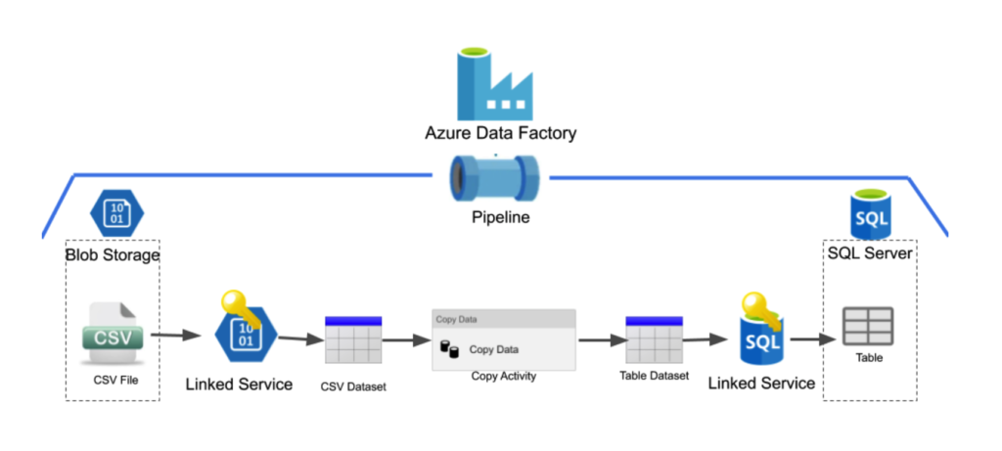
Azure Data Factory

Slide 123
Key Components
Azure Data Factory is composed of below key components
Pipelines
Activities
Datasets
Linked services
Data Flows
Integration Runtimes

Slide 124
Pipelines
A data factory might have one or more pipelines. A pipeline is a logical grouping of activities that performs a unit of work. Together, the activities in a pipeline perform a task.
For example, a pipeline can contain a group of activities that ingests data from an Azure blob, and then runs a Hive query on an HDInsight cluster to partition the data.

Slide 125
Activities
Activities represent a processing step in a pipeline. For example, you might use a copy activity to copy data from one data store to another data store. Similarly, you might use a Hive activity, which runs a Hive query on an Azure HDInsight cluster, to transform or analyze your data. Data Factory supports three types of activities: data movement activities, data transformation activities, and control activities.

Slide 126
Datasets
Datasets represent data structures within the data stores, which simply point to or reference the data you want to use in your activities as inputs or outputs.

Slide 127
Linked services
Linked services are much like connection strings, which define the connection information that's needed for Data Factory to connect to external resources.
A linked service defines the connection to the data source, and a dataset represents the structure of the data. For example, an Azure Storage-linked service specifies a connection string to connect to the Azure Storage account.

Slide 128
Linked services
Linked services are used for two purposes in Data Factory:
To represent a data store that includes, but isn't limited to, a SQL Server database, Oracle database, file share, or Azure blob storage account.
To represent a compute resource that can host the execution of an activity. For example, the HDInsightHive activity runs on an HDInsight Hadoop cluster.

Slide 129
Integration Runtime
In Data Factory, an activity defines the action to be performed. A linked service defines a target data store or a compute service. An integration runtime provides the bridge between the activity and linked Services. It's referenced by the linked service or activity, and provides the compute environment where the activity either runs on or gets dispatched from. This way, the activity can be performed in the region closest possible to the target data store or compute service in the most performant way while meeting security and compliance needs.

Slide 130
Triggers
Triggers represent the unit of processing that determines when a pipeline execution needs to be kicked off. There are different types of triggers for different types of events.

Slide 131
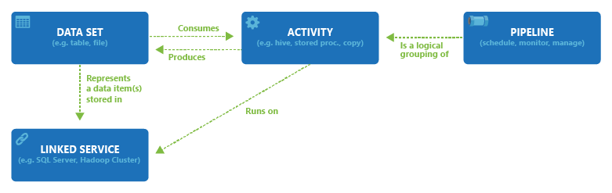
Relationships among pipeline, activity, dataset, and linked services

Slide 132
Lab -7 CREATE AZURE DATA FACTORY ACCOUNT

Slide 133
Different ways to work with Azure Data Factory
Azure Portal UI
Azure PowerShell
.NET
Python
REST API
Resource Manager Template
https://learn.microsoft.com/en-us/azure/data-factory/

Slide 134
Pipeline and Activity
A pipeline is a logical grouping of activities that together perform a task.
For example, a pipeline could contain a set of activities that ingest and clean log data, and then kick off a mapping data flow to analyze the log data. The pipeline allows you to manage the activities as a set instead of each one individually. You deploy and schedule the pipeline instead of the activities independently.
The activities in a pipeline define actions to perform on your data.
For example, you may use a copy activity to copy data from SQL Server to an Azure Blob Storage. Then, use a data flow activity or a Databricks Notebook activity to process and transform data from the blob storage to an Azure Synapse Analytics pool on top of which business intelligence reporting solutions are built.

Slide 135
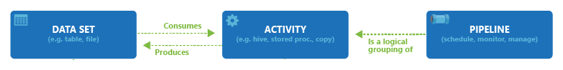
Pipeline and Activity

Slide 136
Types of Activity
Azure Data Factory and Azure Synapse Analytics have three groupings of activities
Data movement activities
Data transformation activities
Control activities
https://learn.microsoft.com/en-us/azure/data-factory/concepts-pipelines-activities?tabs=data-factory

Slide 137
Lab -8 Copy Data Within ADLS Using Copy Data Tool

Slide 138
Lab -9 Copy Data Activity - Copy Specific file Within ADLS

Slide 139
Lab -10 Copy Data Activity - Copy All content From ADLS

Slide 140
Lab -11 Copy Data Activity - Copy from ADLS to SQL DB and Vice Versa

Slide 141
Triggers in Azure Data Factory
Azure Data Factory Triggers are used to schedule a Data Pipeline runs without any interventions. In other words, an Azure Data Factory Trigger is a processing unit that determines when to begin or invoke an end-to-end pipeline execution in Azure Data Factory.
Azure Data Factory Triggers come in three different types:
Schedule Trigger
Tumbling Window Trigger
Event-based Trigger.

Slide 142
Schedule Trigger
Schedule Trigger is a popular trigger that can run a Data Pipeline according to a predetermined schedule. It provides extra flexibility by allowing for different scheduling intervals like minute(s), hour(s), day(s), week(s), or month(s).
You can set the start and end dates for the Schedule Trigger to be active so that it only runs a Pipeline based on the given time period. Furthermore, you can also use the Schedule Trigger to run on future calendar days and times, such as the 30th of each month, the first and third Monday of each month, and more.
The Schedule Azure Data Factory Triggers are built with a “many to many” relationship in mind, which implies that one Schedule Trigger can run several Data Pipelines, and a single Data Pipeline can be run by multiple Schedule Triggers.

Slide 143
Tumbling Window Trigger
The Tumbling Window Azure Data Factory Trigger executes Data Pipelines at a specified time slice or pre-determined periodic time interval. It is significantly more advantageous than Schedule Triggers when working with historical data to copy or migrate data.
Consider the scenario in which you need to replicate data from a Database into a Data Lake on a regular basis, and you want to keep it in separate files or folders for every hour or day. To implement this use case, you have to set a Tumbling Window Azure Data Factory Trigger for every 1 hour or every 24 hours. The Tumbling Window Trigger sends the start and end times for each time window to the Database, returning all data between those periods. Finally, the data for each hour or day can be saved in its own file or folder.

Slide 144
Event-based Trigger
The Event-based Azure Data Factory Trigger runs Data Pipelines in response to blob-related events, such as generating or deleting a blob file present in an Azure Blob Storage. With the Event-based Triggers, you can schedule the Data Pipelines to execute in response to an event from Azure Blob Storage.
In addition, Event-based Triggers are not only compatible with blob, but also with ADLs. Similar to Schedule Triggers, Event Triggers can also work on many-to-many relationships, in which a single Event Trigger can run several Pipelines, and a single Pipeline can be run by multiple Event Triggers.

Slide 145
Lab -12 Perform Trigger in Azure Data Factory

Slide 146
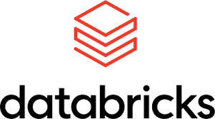
Azure Data Bricks

Slide 147
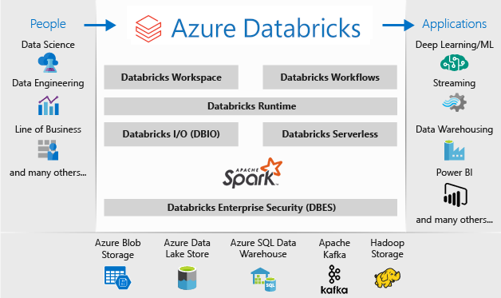
Azure Databricks
Azure Databricks is an Apache Spark-based analytics platform built on top of Microsoft Azure.
Entirely based on Apache Spark, Azure Databricks is used to process large workloads of data that allows collaboration between data scientists, data engineers, and business analysts to derive actionable insights with one-click setup, streamlined workflows, and an interactive workspace.
Azure Databricks is optimized for Azure and tightly integrated with Azure Data Lake Storage, Azure Data Factory, Azure Synapse Analytics, Power BI and other Azure services to store all your data on a simple, open lakehouse and unify all your analytics and AI workloads

Slide 148
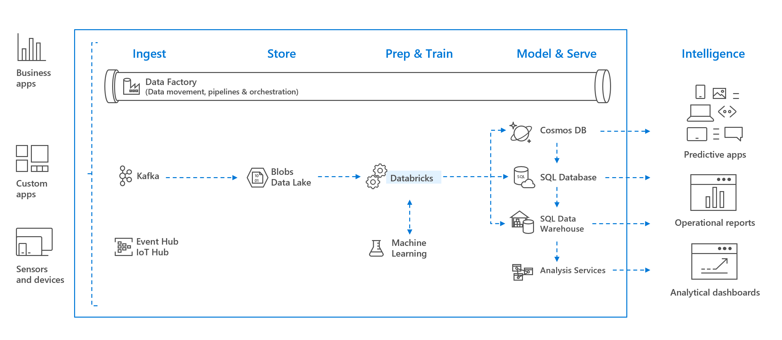
Azure Databricks
Xyz
Zyx

Slide 149
Lab -13 Create Databrick Account

Slide 150
Azure Databricks Workspace
An Azure Databricks workspace is an environment for accessing all of your Azure Databricks assets. The workspace organizes objects such as notebooks, libraries, experiments, queries, and dashboards into folders, and provides access to data and computational resources such as clusters and jobs.

Slide 151
Workspace assets in Azure Databricks
Cluster
Notebooks
Jobs
Libraries
Data
Experiments

Slide 152
Azure Databricks Cluster
An Azure Databricks cluster is a set of computation resources and configurations on which you run data engineering, data science, and data analytics workloads, such as production ETL pipelines, streaming analytics, ad-hoc analytics, and machine learning.
You run these workloads as a set of commands in a notebook or as an automated job.
Azure Databricks makes a distinction between all-purpose clusters and job clusters. You use all-purpose clusters to analyze data collaboratively using interactive notebooks. You use job clusters to run fast and robust automated jobs.
You can create an all-purpose cluster using the UI, CLI, or REST API. You can manually terminate and restart an all-purpose cluster. Multiple users can share such clusters to do collaborative interactive analysis.

Slide 153
Lab -14 Create Databrick Cluster

Slide 154
Workspace assets in Azure Databricks
Notebooks
A notebook is a web-based interface to a document that contains runnable code, visualizations, and explanatory text.
Jobs
Jobs is mechanism for running code in azure data brick.
Libraries
A libraries makes third party or locally –built code available to notebooks and jobs running in your cluster

Slide 155
Azure Databricks architecture overview
Azure Databricks is structured to enable secure cross-functional team collaboration while keeping a significant amount of backend services managed by Azure Databricks so you can stay focused on your data science, data analytics, and data engineering tasks.
Azure Databricks operates out of a control plane and a data plane.
The control plane includes the backend services that Azure Databricks manages in its own Azure account. Notebook commands and many other workspace configurations are stored in the control plane and encrypted at rest.
The data plane is managed by your Azure account and is where your data resides. This is also where data is processed. You can use Azure Databricks connectors so that your clusters can connect to external data sources outside of your Azure account to ingest data or for storage. You can also ingest data from external streaming data sources, such as events data, streaming data, IoT data, and more.

Slide 156
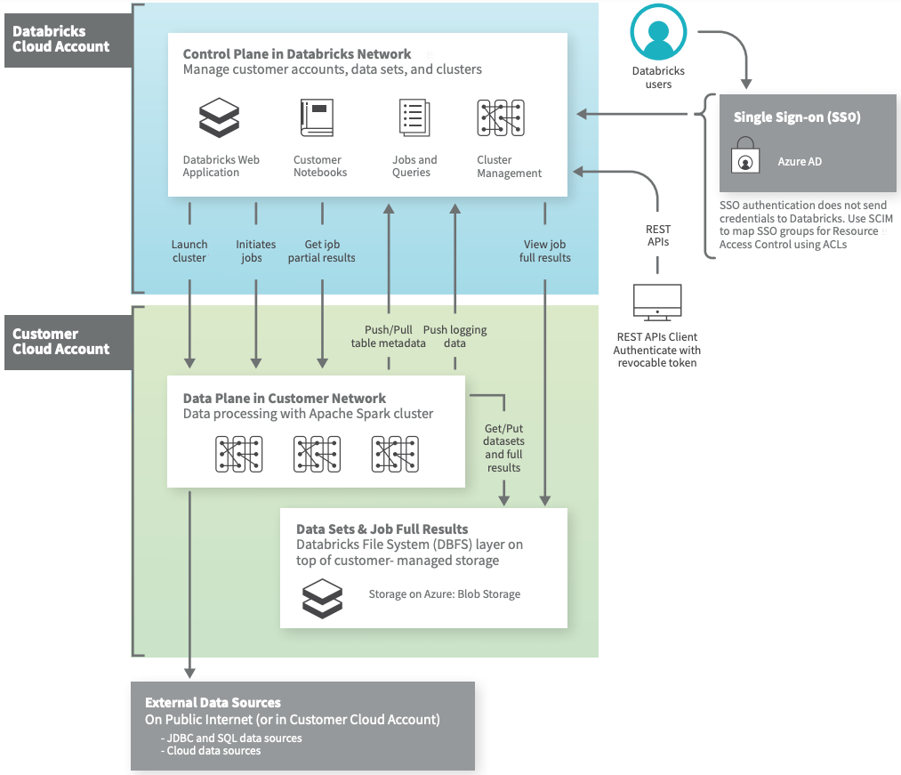
Azure Databricks architecture overview

Slide 157
Databricks File System(DBFS)
The Databricks File System (DBFS) is a distributed file system mounted into an Azure Databricks workspace and available on Azure Databricks clusters. DBFS is an abstraction on top of scalable object storage.
The DBFS root is the default storage location for an Azure Databricks workspace, provisioned as part of workspace creation in the cloud account containing the Azure Databricks workspace.
/FileSrorage
/databricks-datasets
/databricks-results

Slide 158
Browse DBFS using UI
An admin user must enable the DBFS browser interface before you can use it
Go to admin console
Click the workspace setting tab
In advanced section , click the DBFS File system toggle and then click on confirm
To see the all file folders in DBFS
dbutils.fs.ls('/’)
display(dbutils.fs.ls('/’))
display(dbutils.fs.ls('dbfs:/databricks-datasets/'))

Slide 159
Databricks Utilities(dbutils)
Databricks Utilities (dbutils) make it easy to perform powerful combinations of tasks. You can use the utilities to work with object storage efficiently to Chain Notebook, To parameterize notebooks, and To work with secrets.
Note : dbutils are not supported outside of notebooks.
https://learn.microsoft.com/en-us/azure/databricks/dev-tools/databricks-utils

Slide 160
Lab -15 Databricks Utilities(dbutils) LAB

Slide 161
Lab -16 Create and Run Spark Job in Databricks

Slide 162
Lab -17 Access Azure data lake

Slide 163
Lab -18 Read multiple files in single Dataframe

Slide 164
Lab -19 Impose Schema Using DDL String

Slide 165
Lab -20 Rename Columns In DataFrame

Slide 166
Azure Virtual Network

Slide 167
Azure Virtual Network
Azure virtual networks enable Azure resources, such as VMs, web apps, and databases, to communicate with each other, with users on the internet, and with your on-premises client computers.
Azure virtual networks provide the following key networking capabilities:
Isolation
Internet communications
Communicate between Azure resources
Communicate with on-premises resources
Connect virtual networks
https://learn.microsoft.com/en-gb/training/modules/azure-networking-fundamentals/azure-virtual-network-fundamentals

Slide 168
Element of Azure Virtual Network
Subnet
Routing
Network Security Group
Address space
Regions.
Subscription

Slide 169
Why use an Azure Virtual network
Azure virtual network enables Azure resources to securely communicate with each other, the internet, and on-premises networks. Key scenarios that you can accomplish with a virtual network include - communication of Azure resources with the internet, communication between Azure resources, communication with on-premises resources, filtering network traffic, routing network traffic, and integration with Azure services.

Slide 170
Communicate between Azure resources
Through a virtual network
Through a virtual network service endpoint
Through VNet Peering

Slide 171
Virtual network peering
Azure supports the following types of peering:
Virtual network peering: Connecting virtual networks within the same Azure region.
Global virtual network peering: Connecting virtual networks across Azure regions.

Slide 172
Virtual Network service endpoints
Virtual Network (VNet) service endpoint provides secure and direct connectivity to Azure services over an optimized route over the Azure backbone network. Endpoints allow you to secure your critical Azure service resources to only your virtual networks. Service Endpoints enables private IP addresses in the VNet to reach the endpoint of an Azure service without needing a public IP address on the VNet.

Slide 173
Lab VNet Configuration

Slide 174
Azure Key Vault
Azure Key Vault is a cloud service for securely storing and accessing secrets. A secret is anything that you want to tightly control access to, such as API keys, passwords, certificates, or cryptographic keys.

Slide 175
Configure, Validate, and Deploy ARM Templates

Slide 176
ARM Templates
The ARM template is a JavaScript Object Notation (JSON) file that defines the infrastructure and configuration for your project.
"resources": [
{
"type": "Microsoft.Storage/storageAccounts",
"apiVersion": "2019-04-01",
"name": "mystorageaccount",
"location": "westus",
"sku": {
"name": "Standard_LRS"
},
"kind": "StorageV2",
"properties": {}
}
]

Slide 177
Lab : Launching VM using ARM Templates

